Slide 1

SIG React 04-09-2018

Slide 2
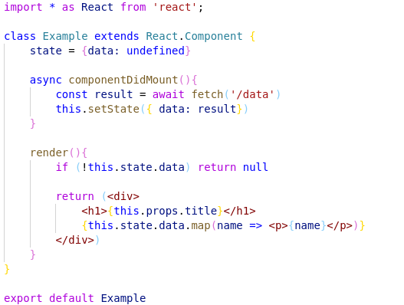
Recap
React
1

Slide 3
Format
<Subject />
Theory
Hands-on
Live coding (if needed)
React
1

Slide 4
What are we gonna build?
Snippet
Authorization flow
Login functionality
Bonus: Register functionality
Create accommodation
Connect to Redux
React
1

Slide 5
But first: Getting started
Git clone or git pull https://github.com/AMIS-Services/react-series
Cd into dir sig3/exercise/koa, run:
`yarn install`
`yarn start-db`
`yarn start`
`yarn seed-db`
Visit localhost:3030/accommodations to verify back-end is working
Cd into dir sig3/exercise/react, run `yarn` or `npm install` and `yarn/npm start`
Visit localhost:3000 to verify front-end is working
React
1

Slide 6
Snippets
Prevent you from writing boilerplate
Can be project specific or saved globally
Project in repo has some snippets included already
We will build ourselves a convenient snippet for the rest of the day
For documentation see:
https://code.visualstudio.com/docs/editor/userdefinedsnippets
React
1

Slide 7
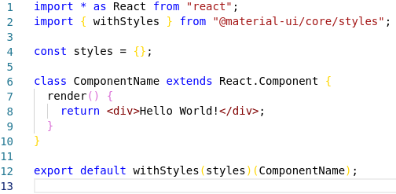
Hands-on: Snippets
Open /.vscode/components.code-snippets
Copy the first snippet “component” and use the base code to create a styledComponent
After creating and using the snippet, it should result in the following code:
React
1

Slide 8
JSS
Last time we covered JSS
But no hands-on due to time constraints
It is CSS inside your javascript file
No inheritance of parent to child components
More control
Can be injected into component by WithStyles (Material UI)
Some syntax specific changes compared to CSS
React
1

Slide 9
Hands-on: JSS
Translate CSS file to JSS
React
1

Slide 10

Context API
For when the same information is required in multiple far-removed components
Requires initialization, a provider and one or more consumers
Initialization is done outside of a component:
The provider is passed the value:
Child of Consumer is a function:
If you want your context available outside of the render method, set the classes contextType below the class:
N.B. Export context API from it’s own separate file to prevent cyclic dependencies when using the contextType notation
N.B. If you want to pass functions, put them in state and pass the whole state object
React
1

Slide 11
Hands-on: Setting up a user context
Create a file called context.js in `src/common`
Initialise a context called UserContext and export it
Import the context in Frame.js and use it in a <UserContext.provider />
Add state to the Frame component, consisting of a currently undefined user and a login function
In the login function, use the login function from src/common/auth.js. Set sate.user to the user it returns
As the UserContext value pass entire state
Wrap the JSX the Appbar returns in a <UserContext.Consumer /> and conditionally show either the users userName or the word login, depending on whether user is logged in or not
BONUS: Add logging out
React
1

Slide 12
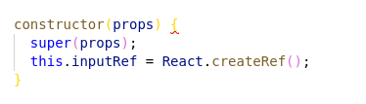

Uncontrolled forms
Initialise the ref in the constructor:
Use a callback to link the DOM element to the ref
The value of the ref is available in `this.inputRef.value`
N.B. Material UI <Input /> or <TextField /> use inputRef instead of ref
React
1

Slide 13

Hands-on Time!
Login
Functional Demo
React
<number>

Slide 14
Hands-on: Uncontrolled form
Create a LoginDialog component, pass it the properties open (a boolean) and handleClose (a function)
In the render method, return a MUI <Dialog />. Pass it the property open from your LoginDialog props.
Add two Inputs for email and password as well as a Button from MUI
Initialize two refs in the constructor and add them to the Inputs using callbacks in their inputRef property
Create a handleLogin function and add it to the onClick of the button.
Below your class, add `LoginDialog.contextType = UserContextAdd the login logic from your context to your handleLogin function.
Change the <Appbar /> render to contain the <LoginDialog />. Add the necessary functions and state members to manage the `open` prop of the LoginDialog. Pass LoginDialog the necessary function in handleClose
BONUS: make the ‘favorite’ on the accommodations work again. The favorite accommodations list can be found on the user object.
BONUS: add validation to the ‘email’ field of the login dialog
React
<number>

Slide 15
Controlled forms
Initialize the state for the inputs
Set input value to equal state
Add onChange handlers to the inputs
React
<number>

Slide 16
Hands-on Time!
Create accommodation form
Functional Demo
React
<number>

Slide 17
Hands-on: Controlled form
Add a new page at `/create`
Add a routerlink inside the Appbar, linking to /create
The link should only be visible/clickable to logged in users
Add a MUI TextField for name, location, foto url, description and a MUI (multi)select for amenities (faciliteiten)
See: https://material-ui.com/api/select/
Have the input values depend on state and add functions for the inputs’ `onChange`
Add a submit button which posts the accomodation to `localhost:3030/accommodations` using the fetch function from ‘src/common/fetc’
Bonus: add a create new user page at `/register`
React
<number>

Slide 18
Redux
Explain some theory
React
<number>

Slide 19
Hands-on: Redux actions
Create a file: src/store/accommodations/actions.js
Export a function getAllAccommodations which returns an async function which takes a parameter called dispatch. HINT: this async means you will want to use `await`.
In the returned function, dispatch an object with the attribute type set to “REQUEST_ACCOMMODATIONS”
Move the accommodations fetch from Accommodations.js to here
If the Fetch is successful dispatch a second object with type “RECEIVE_ACCOMMODATIONS” and the accommodations as payload. If the Fetch is unsuccessful dispatch an object with type “ERROR_ACCOMMODATIONS”
Suggestion: put the type strings in a constant which you export, so you can use the same strings later
React
<number>

Slide 20
Hands-on: Redux reducer
Create a file: src/store/accommodations/reducer.js
Add the reducer function
It takes a state (default empty array) and an action (default empty object)
It contains a switch for the action.type
By default it returns the state
Add a case for ‘REQUEST_ACCOMMODATIONS’, ‘ERROR_ACCOMMODATIONS’ and ‘RECEIVE_ACCOMMODATIONS’
In the request and error case return state
In the receive case put the accommodations you just fetched in the state
React
<number>

Slide 21
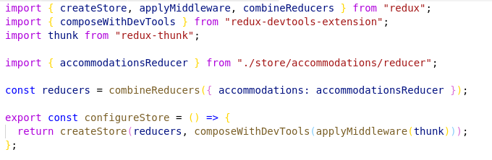
Hands-on: Redux store
Create a store configuration file in src/store:
Initialize and provide the store by assigning the return from configureStore() to a constant in your App.js. Wrap <Provider /> from react-redux around the rest of your app.
React
<number>

